Slide 1


Artful Accessibility -
Individuals with Mobility Disabilities in Art Exhibition
Final Project Phase -61999
24-2-D-6
Marysoul Karawany
Mustafa Shama
Supervisor:
Dr. Julia Sheidin
Notes:
Hello everyone, today we are excited to present our project, Artful Accessibility.
I’m Mustafa, alongside my partner Marysoul, under the guidance of our supervisor, Julia.

Slide 2

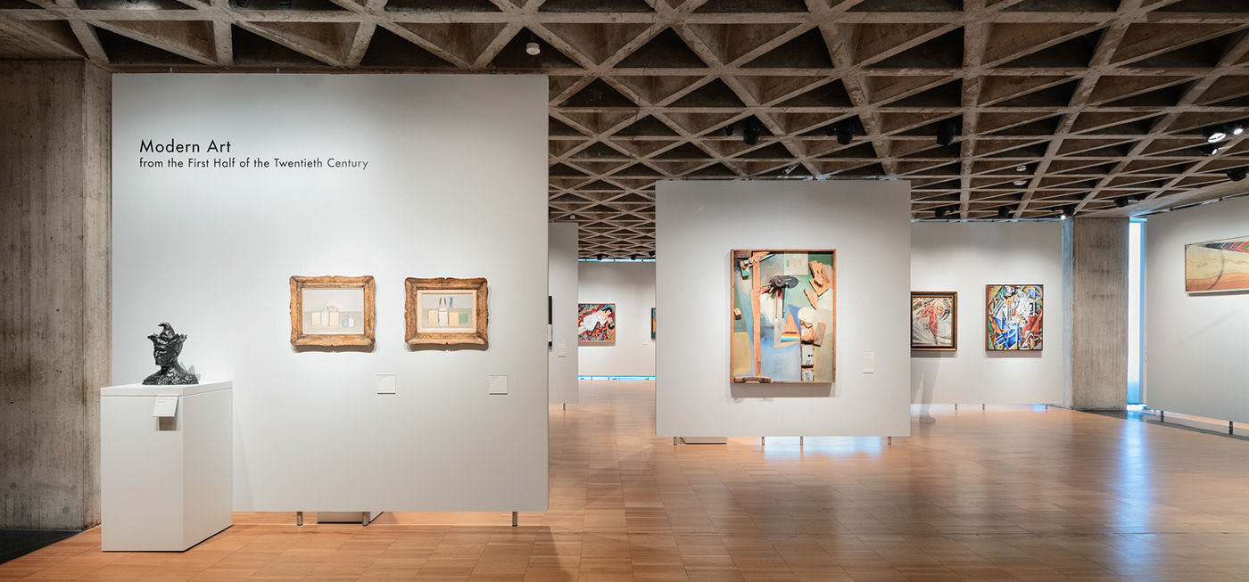
Introduction
Art has the power to inspire, connect, and tell stories. With the help of modern technology, we can reimagine how people experience and interact with art, making it more accessible and enjoyable for everyone.

Slide 3


The Problem
Artwork can be hard to see for visitors with mobility challenges because some displays are placed too high or at fixed heights.
The Solution
Our system automatically adjusts painting heights for the best view. Using proximity sensors, cameras, and a microcontroller, it detects wheelchair users and adjusts the artwork accordingly. It also includes a Maintenance and Monitoring System to track connectivity, real-time interactions, and system health to ensure reliable operation.

Slide 4
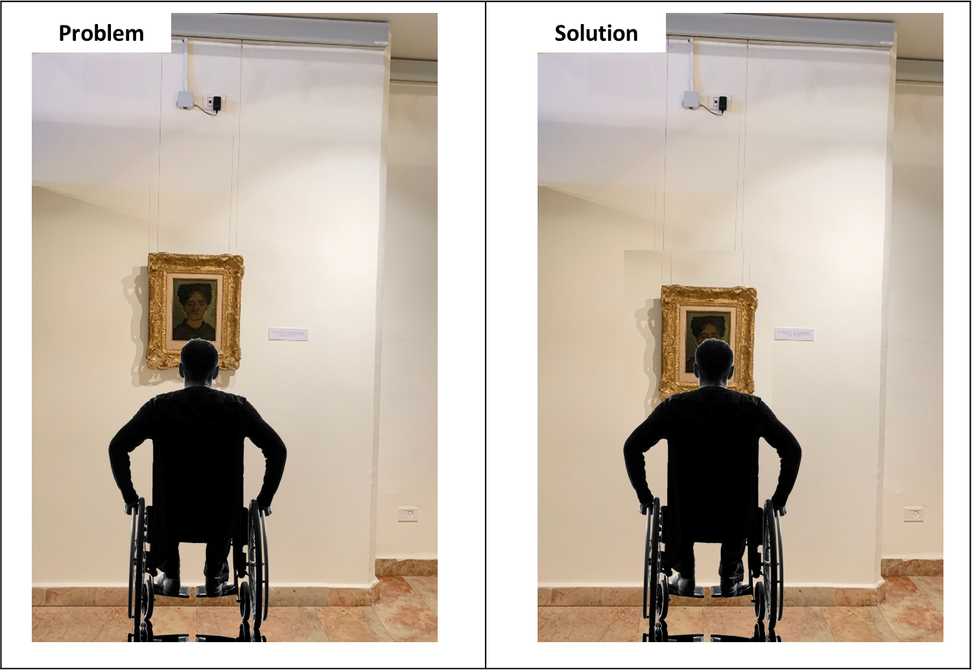

Slide 5
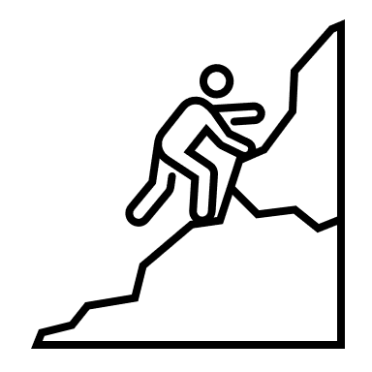


Project Flow
Research
System Development
Testing

Slide 6
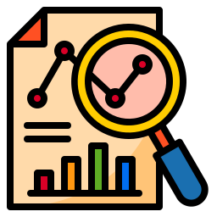
Project Flow
Research
System Development
Testing

Slide 7
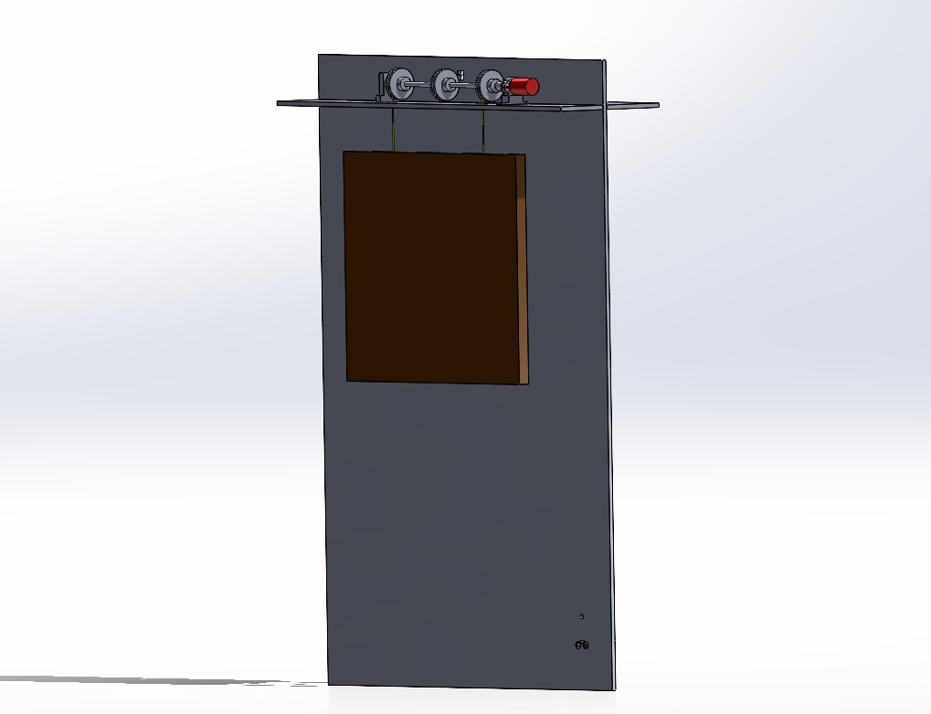
Research
Planning and Defining System Components:
Developed a clear plan to structure the project and define all necessary system components.
Identified key areas of focus, including accessibility needs, system scalability, and real-time functionality.
Collaboration with the Mechanical Department:
Established a collaborative workflow with the mechanical team to design and integrate physical components.
Addressing Challenges:
Recognized potential integration and compatibility issues early on and planned solutions to address them efficiently.
The Prototype photo

Slide 8

Project Flow
Research
System Development
Testing

Slide 9
System Flow Process
Visitor Detection: Distance sensor detects visitor presence.
Image Processing: Camera captures frames; sent to server for wheelchair detection.
Height Adjustment: Server calculates adjustment; command sent to motor.
Reset:
Painting returns to default height after visitor leaves.
Notes:
I’ll explain how our system process works in general .
Let’s say a persong is a approaching a certain painting, First step, we use a distance sensor to detect when a visitor approaches the painting. Next, a camera captures images and sends them to a server, which checks if the visitor is using a wheelchair. If a wheelchair is detected, the program calculates the right height to match eye level of person,
and sends a command to the motor to adjust the painting. Finally, when the visitor leaves, the painting automatically resets to its default height.

Slide 10
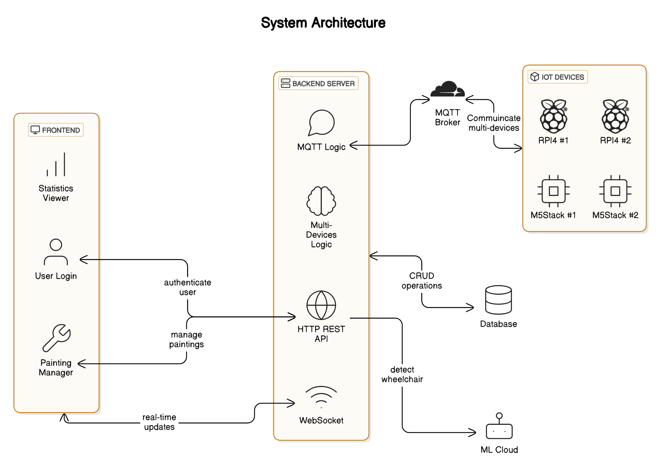
Notes:
Now I will speak the overview of our system architecture
Our system consist of frontend, backend, Machine learning on a cloud, and finally iot devices
In the next slides we will speak about each aspect in depth.

Slide 11

Notes:
Firsly, I will start speaking about iot devices in depth

Slide 12
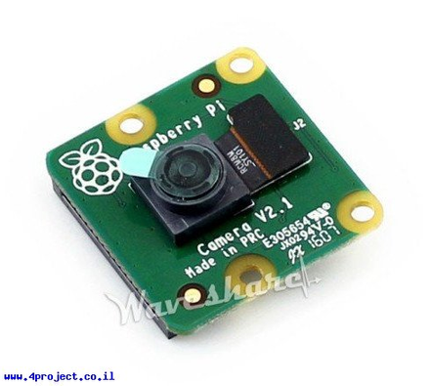
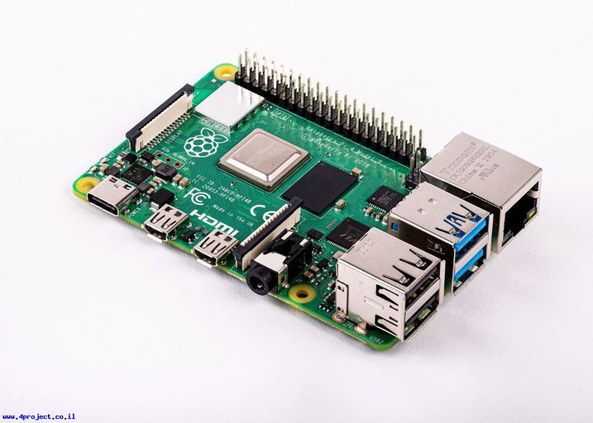
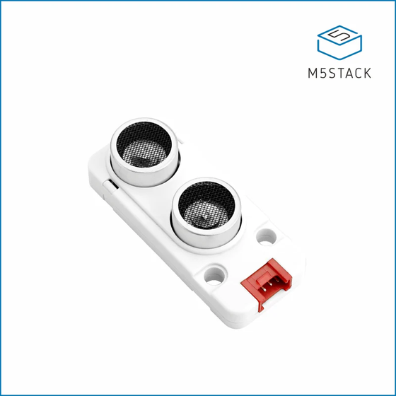
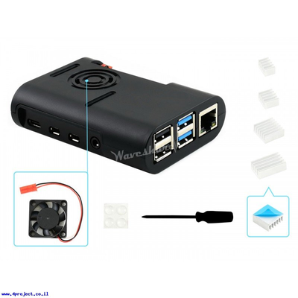
1. IOT Device Components
Raspberry Pi 4 Model B (4GB RAM)
Raspberry Pi Camera Module v2 (8MP)
Ultrasonic Distance Sensor (5V, I2C)
Plastic Cover with Fan
Notes:
Our devices consisit of rasperri pi microcontroller, a camera for analyzing imgaes, ultrasonic distance sensor for detecting people approaching,
And lastly a case with fan for cosmetic and heating reasons

Slide 13
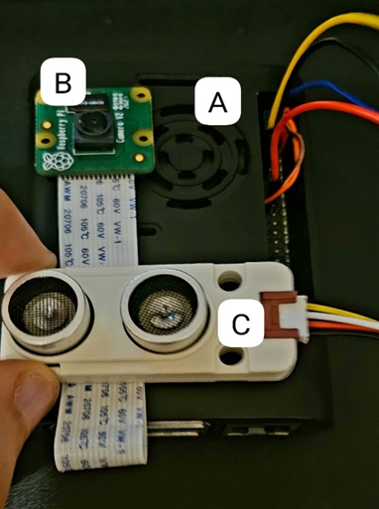
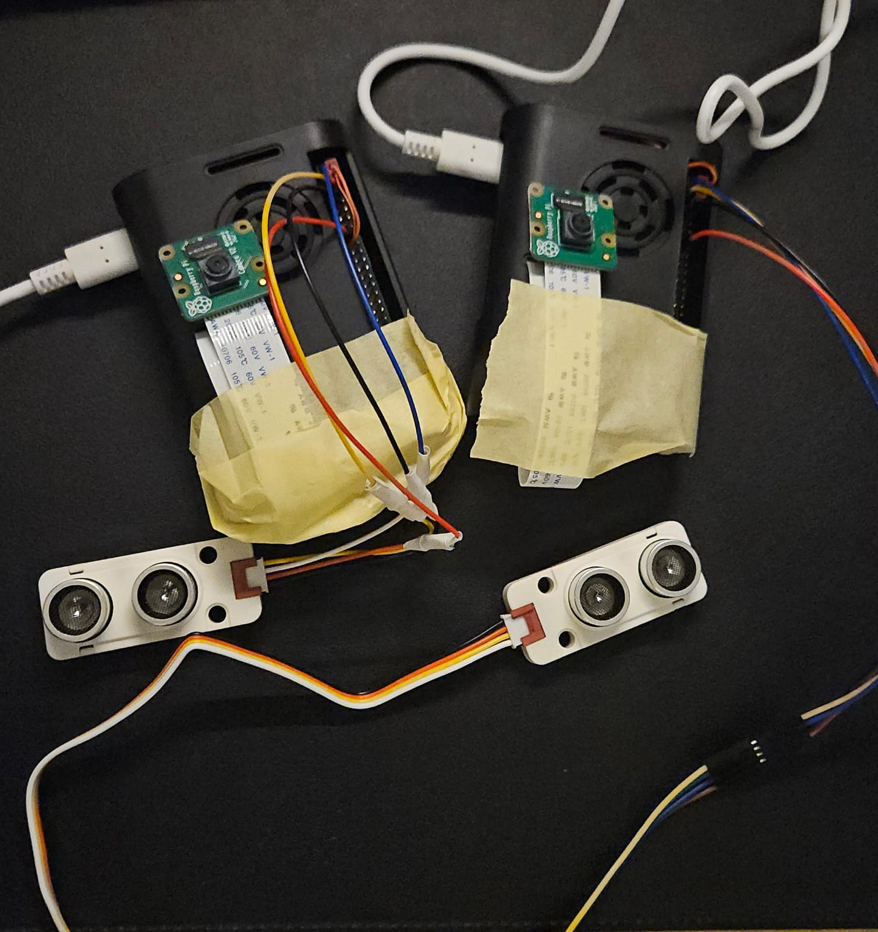
How It All Connects?
Notes:
That is how we connected all the components together,
we worked on 2 devices, each device has its own camera and sensor,
our system can handle multiple devices and we will show how in video
We also integrated our devices with m5stack, which is the microcontroller for the mechincal team

Slide 14


Slide 15
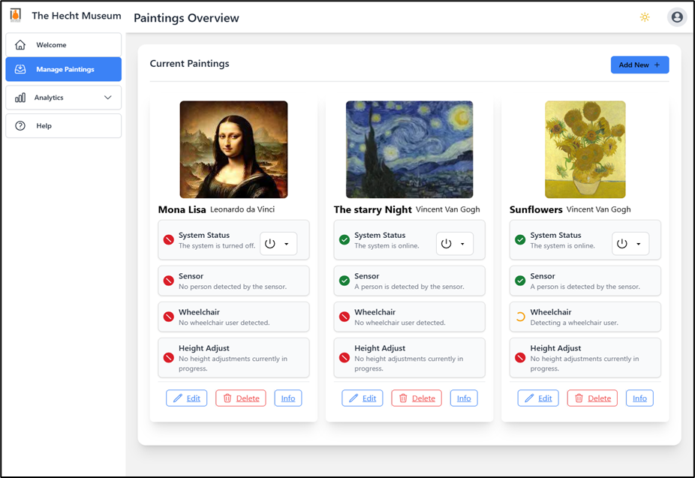
1. Frontend – Painting Managements
Real-time painting status
Easily add/remove/connect devices.
Remote start & shutdown
Ensures smooth operation & accessibility

Slide 16

Notes:
Now I will talk about the backend server,
Which is the backbone of our system because it handles every aspect of the system

Slide 17

3. The Backend
Node.js: High-performance server-side logic and asynchronous operations.
Central hub for system architecture
Network Communication: Handles talking with frontend, IoT devices, MQTT Broker and Machine learning cloud
Parallel system: handles multiple IoT devices for wheelchair detection simultaneously.
Notes:
For that reason we choose NodeJS, which can handle asynchronous operations, which is good for our system because coming to 3rd point
The backend handles commucating with frontend, iot, mqtt broker, cloud

Slide 18


Slide 19
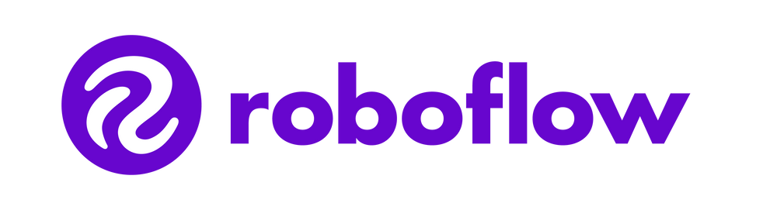
Computer vision for object detection
Powered by Roboflow 3.0:
Cloud-based object detection for real-time analysis.
Identifies visitors and wheelchair usage with high accuracy.
Detection Workflow:
Captures images with Raspberry Pi Camera.
Sends images to Roboflow for processing.
Backend calculates height adjustments and commands hardware.
Scalable and Adaptive:
Cloud-based processing reduces local hardware load.
Active learning improves model accuracy over time.
Integrated with System:
Works seamlessly with backend and hardware for real-time adjustments.

Slide 20
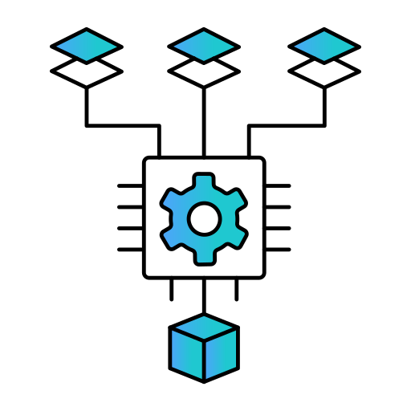
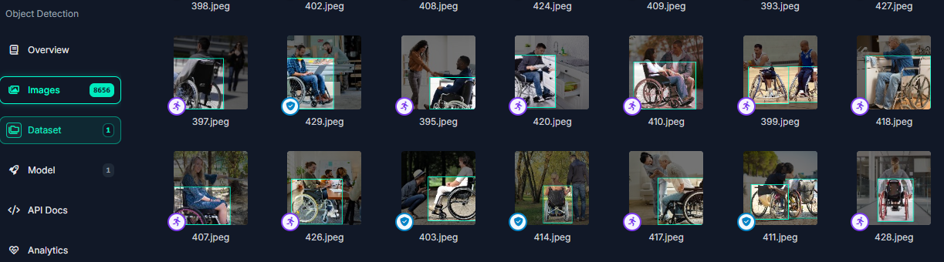
Training Dataset
Comprehensive Dataset:
Trained on over 8,000 images of wheelchairs and visitors. Designed for diverse lighting and environmental conditions.

Slide 21

Notes:
Now I will talk bout the MQTT Broker, which connectes between multiple iot devices without backend server.

Slide 22
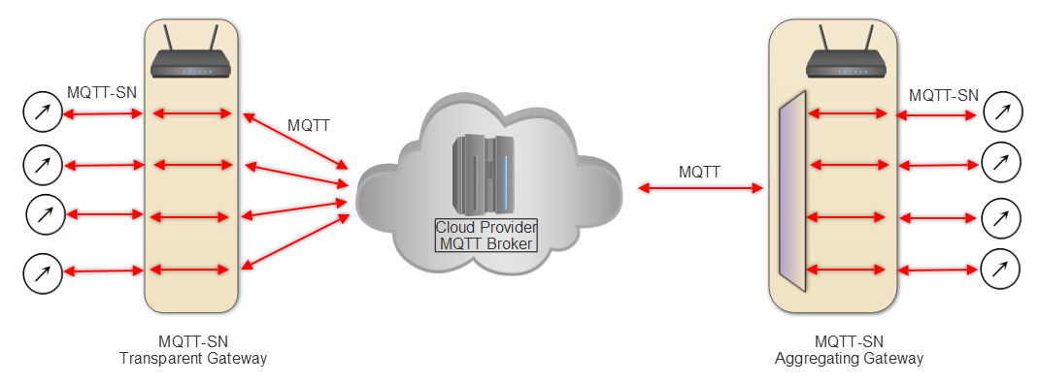
Networking for Communication
MQTT is a lightweight protocol designed for real-time communication in IoT systems.
There are 3 types use cases for MQTT to integrate communication with the mechanical team and the software team microcontroller with backend server.
Install new devices to the system.
Deleting Devices from the system
The Main system process of detection and height adjustment from a specific painting’s device.

Slide 23
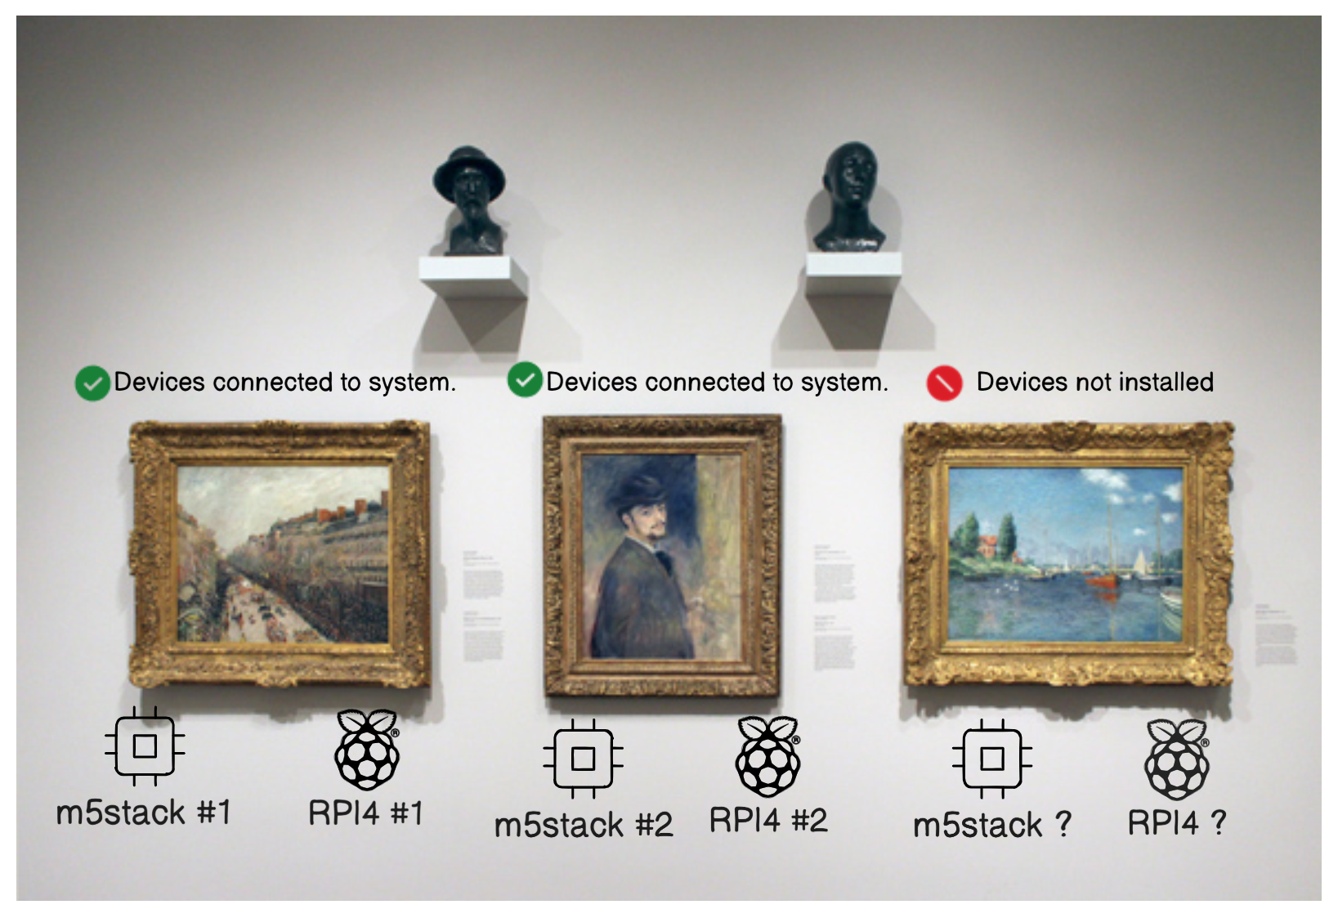
1.Installation of New Painting device
User Input: Painting details (dimensions, initial height, name).
Backend Processing: Broadcast to "install" topic for all devices.
Microcontrollers: Store sys_id and send success acknowledgment.
Real-Time Communication: Subscribe to painting-specific topics for future updates.
Notes:
Lets say we have 3 paintings, the first two painting are already registered in the system but we want to install new devices on the 3rd painting which is not connected or registered in our system yet.
How we can do that in easy way and no technical configurations needed?
The user only has to put the name painting in the frontend, and the backend will handle all the logic automatically by installing new devicing using the mqtt protocol
All the iot devices will be listening to the mqtt and the backend will send a wave of broadcast to all the devices, but only the not regsitred devices will answer to that broadcast and accept to take a system id from the backend.

Slide 24

The video
Watch the Video Here

Slide 25
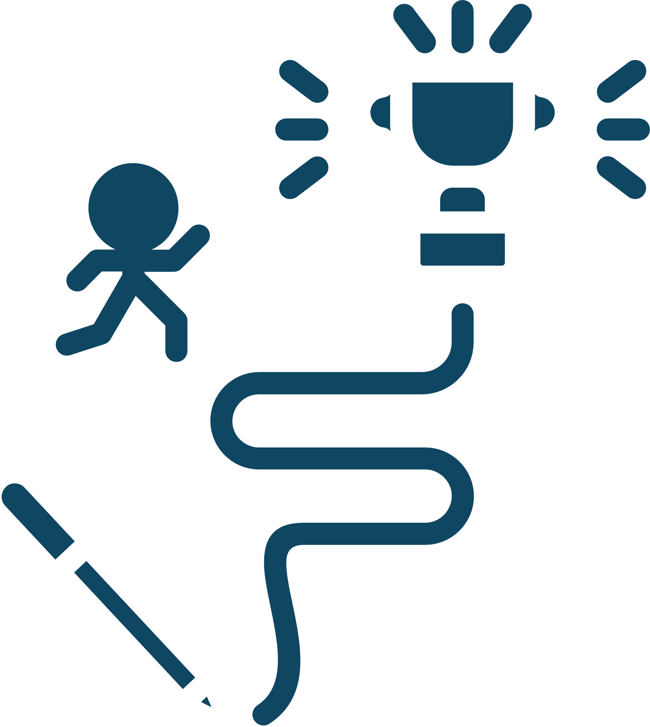
Challenges
1. Selecting the Optimal Tools and Technologies
Identifying compatible and scalable hardware, software, and communication protocols.
2. Integrating Physical and Software Systems
First-time integration of hardware components (motors, sensors, cameras) with the software system.
3. Software team working with Mechanical Team (vice versa)
Difficulty understanding concepts on how Integrate our work together.

Slide 26
Conclusion
Successfully developed a dynamic painting adjustment system to enhance accessibility, especially for wheelchair users.
Integrated advanced technologies like computer vision and MQTT-based communication.
Used simulations to refine and validate the system’s functionality and scalability.
Designed the system to work with multiple paintings simultaneously.
Developed a Maintenance and Monitoring System to track connectivity, real-time interactions, and system health.
Created a user-friendly frontend for efficient system management.

Slide 27
Future work
Deploy the system in real art galleries or museums environments for practical usage and validation.
Fully integrate the mechanical components with the software system for seamless operation.
Convert the Maintenance and Monitoring System into a mobile app for easier access and usability.

Slide 28

Thank You !
Questions?

